Slide 1


Acropolis Institute of Technology and Research
Department of Computer Science and Information Technology

Slide 2
PROJECT GUIDE- PROF. VANDANA KATE MEMBERS- COORDINATORS- PROF. SUSHMA KHATRI DHRUV GHODE - 0827CI191017 PROF. ANKITA AGARWAL NIDHI MEHTA - 0827CI191039
Facial Emotion Recognition

Slide 3
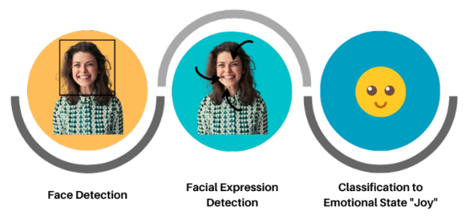
Facial Emotion Recognition is a technology used for analyzing sentiments by different sources, such as pictures and videos.
FER analysis comprises three steps:
i) face detection
ii) facial expression detection
iii) expression classification to an emotional state

Slide 4
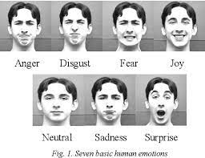
Potential uses of FER cover a wide range of applications-
i) Provision of personalized services
ii) Customer behavior analysis and advertising
iii) Healthcare
iv) Employment
v) Education
vi) Public safety
vii) Crime detection

Slide 5
Implementation

Slide 6
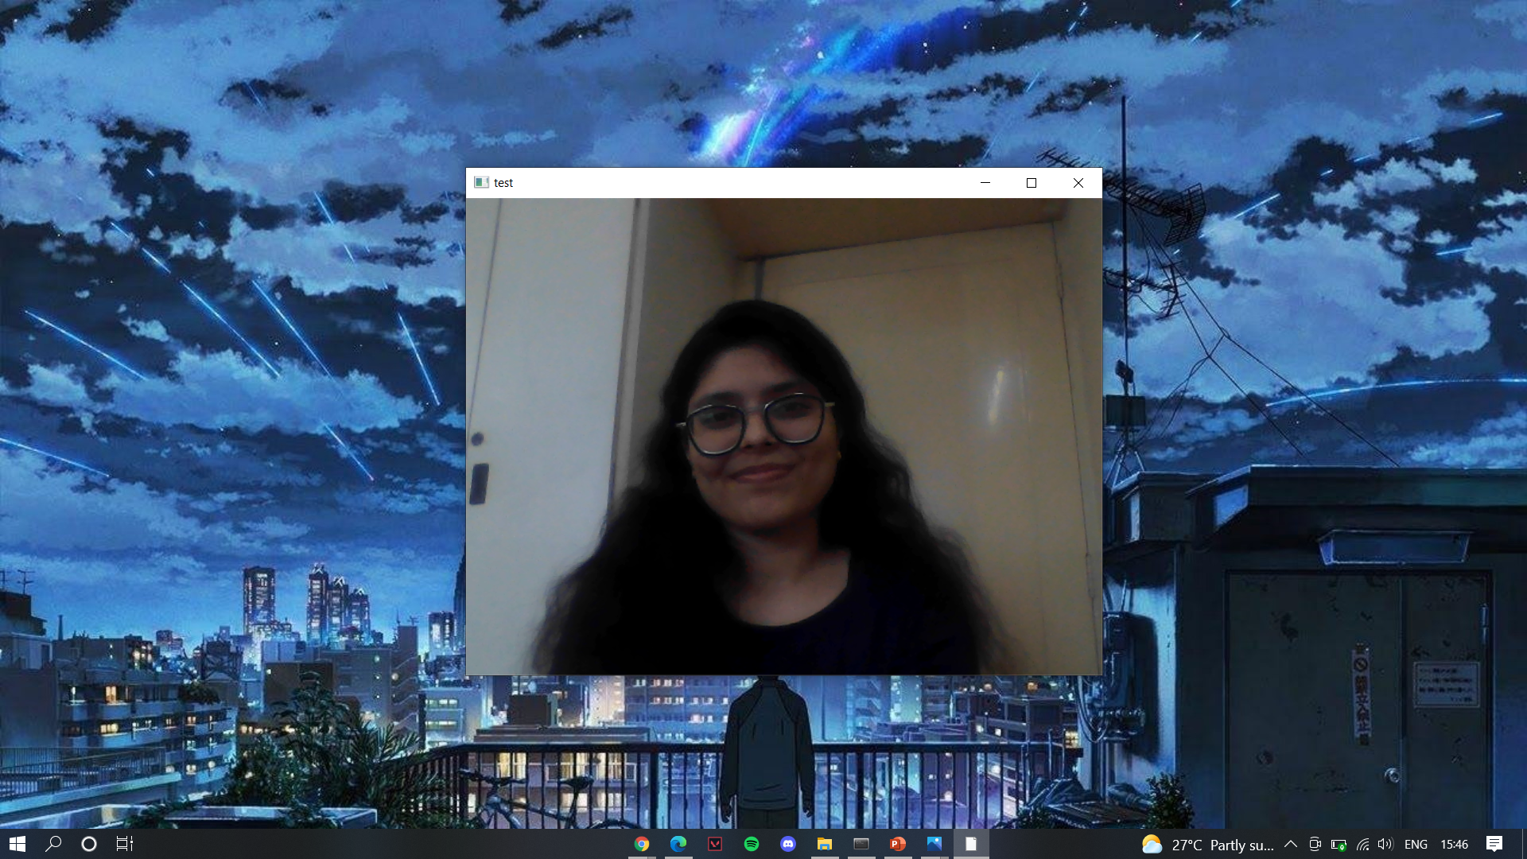
1. Automated starting webcam and capturing image (Using cv2)

Slide 7
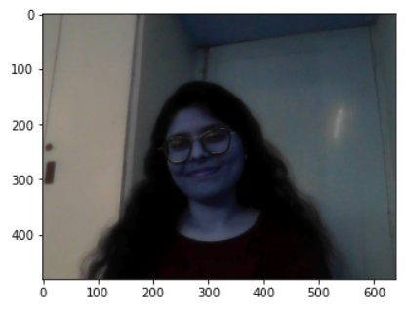
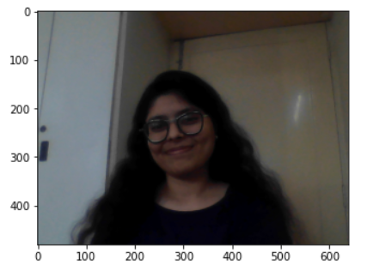
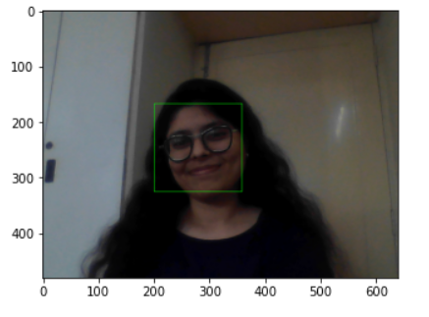
2. Processing of captured image in the backend (Using matplotlib and haarcascade)
i) Plotting according to the size of image
ii) Converting the captured image from BGR to RGB
iii) Identify and extract the face from the image and mark

Slide 8

3. Analyzing dominant emotion from facial expressions (Using deepface)

Slide 9
We’re eager to know your opinions and recommendations, if you have any.

Slide 10
THANKYOU!

